Slide 1










Three methods of activating electronic collections in the consortial environment
Yoel Kortick. Senior Librarian
http://www.julac.org/

Slide 2


Introduction
CZ electronic collection
CZ electronic collection with updated bibliographic information
NZ local electronic collection
text
https://slidemodel.com/templates/animated-rainbow-business-powerpoint-template/
http://image.shutterstock.com/z/stock-photo-business-hand-writing-blank-agenda-list-130255148.jpg

Slide 3
Introduction
We will outline here three methods of activating electronic collections in the consortial environment:
CZ electronic collection
  Electronic Collection from the Community Zone is activated in the network zone and used “as is”
CZ electronic collection with updated bibliographic information
  Electronic Collection from the Community Zone is activated in the network zone and then additional bibliographic information is loaded in network zone to enrich the records
NZ local electronic collection
  Local electronic collection with a bibliographic record and multiple portfolios is created in the NZ. There is no connection to the CZ.

Slide 4
Introduction
In all three cases the “available for” can be controlled via inventory network groups and “available for” group settings.
See separate presentation for an in depth analysis and demonstration of the inventory network groups and “available for” group settings.

Slide 5
Introduction
CZ electronic collection
CZ electronic collection with updated bibliographic information
NZ local electronic collection
text
https://slidemodel.com/templates/animated-rainbow-business-powerpoint-template/
http://image.shutterstock.com/z/stock-photo-business-hand-writing-blank-agenda-list-130255148.jpg

Slide 6
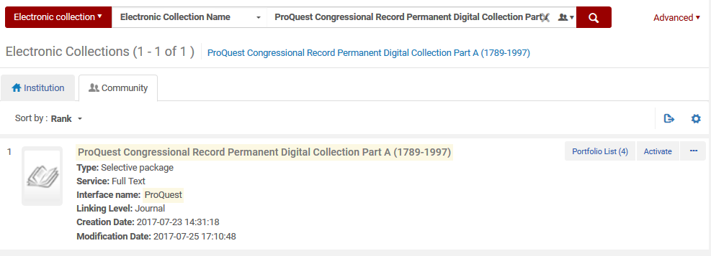
CZ electronic collection – example 1
While logged into the network zone we search the community zone for a electronic collection “ProQuest Congressional Record Permanent Digital Collection Part A (1789-1997)” and click activate

Slide 7
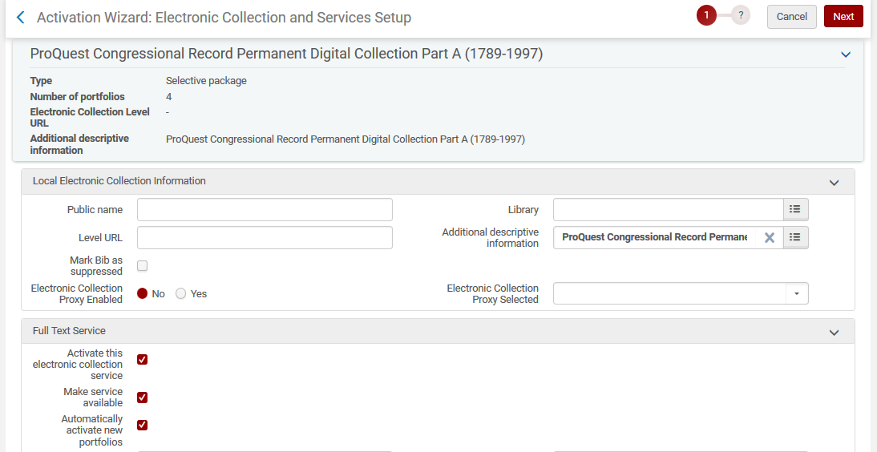
CZ electronic collection – example 1
In the activation wizard we will choose full text service “Automatically activate new portfolios” and “Make service available” and “Automatically activate new portfolios”

Slide 8
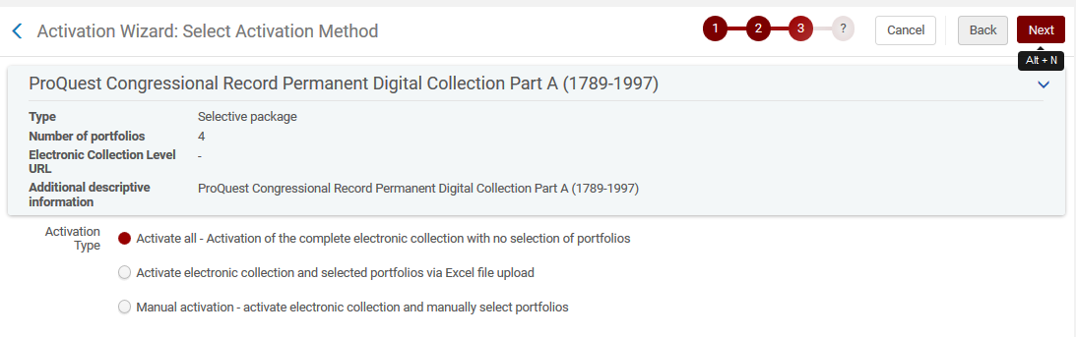
CZ electronic collection – example 1
In the activation wizard we will choose activation type “Activate all – Activation of the complete electronic collection with no selection of portfolios”

Slide 9
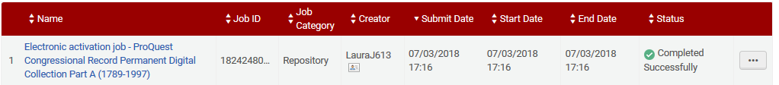
CZ electronic collection – example 1
The “Electronic activation job” runs in the background

Slide 10
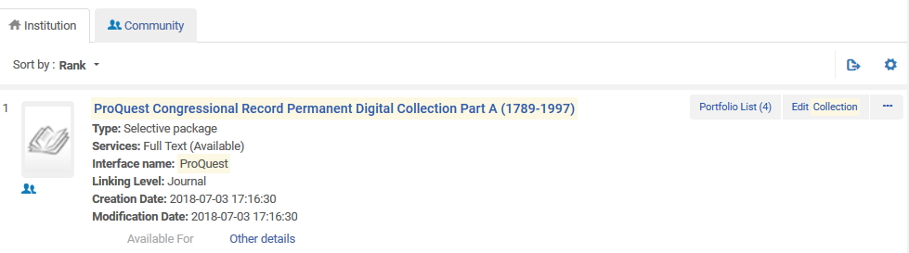
CZ electronic collection – example 1
Now the electronic collection is active in institution of the network zone

Slide 11
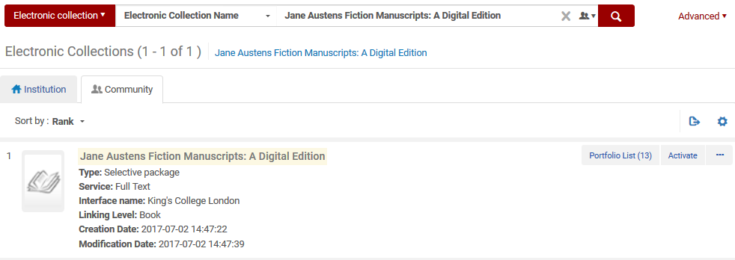
CZ electronic collection – example 2
While logged into the network zone we search the community zone for a electronic collection “Jane Austens Fiction Manuscripts: A Digital Edition” and click activate

Slide 12
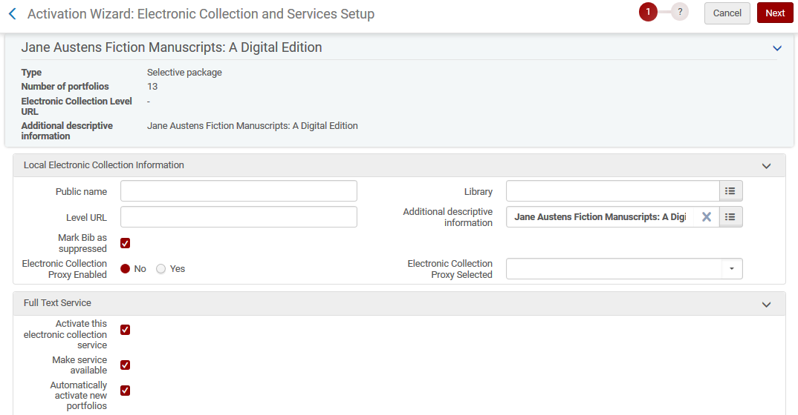
CZ electronic collection – example 2
In the activation wizard we will choose full text service “Automatically activate new portfolios” and “Make service available” and “Automatically activate new portfolios”

Slide 13
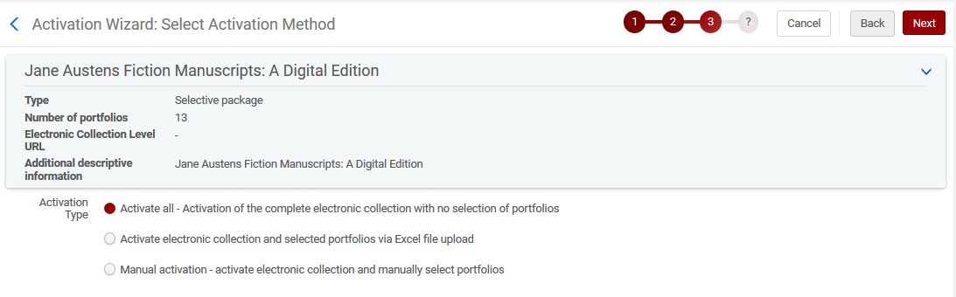
CZ electronic collection – example 2
In the activation wizard we will choose activation type “Activate all – Activation of the complete electronic collection with no selection of portfolios”

Slide 14
CZ electronic collection – example 2
The “Electronic activation job” runs in the background

Slide 15
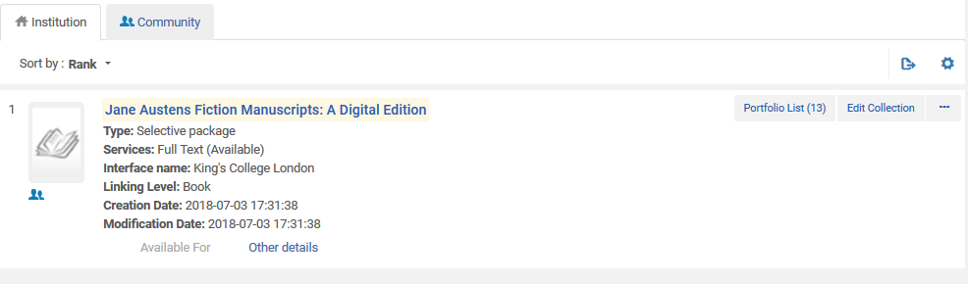
CZ electronic collection – example 2
Now the electronic collection is active in institution of the network zone

Slide 16
Introduction
CZ electronic collection
CZ electronic collection with updated bibliographic information
NZ local electronic collection
text
https://slidemodel.com/templates/animated-rainbow-business-powerpoint-template/
http://image.shutterstock.com/z/stock-photo-business-hand-writing-blank-agenda-list-130255148.jpg

Slide 17
CZ electronic collection with updated bibliographic information
We now have two portfolios in the network institution, each has been activated from the CZ:
“ProQuest Congressional Record Permanent Digital Collection Part A (1789-1997)”
  Has 4 portfolios
“Jane Austens Fiction Manuscripts: A Digital Edition”
  Has 13 portfolios

Slide 18
CZ electronic collection with updated bibliographic information
  The institution then has a MARC file of the bibliographic records of the portfolios of each collection, as well as perhaps the bibliographic records of the collection.
  The MARC file contains enriched bibliographic data
  The network institution loads the file into the network zone and overlays (or merges) the existing record which was the result of the activation from the CZ.
  As a result the network institution has bibliographic records which
  Contain enriched bibliographic data
  Electronic inventory still linked to the CZ

Slide 19
CZ electronic collection with updated bibliographic information
  We will now look at part of the MARC file which we will import.
  In our sample here it contains 5 records:
  1 record is the bibliographic record of the electronic collection electronic collection “ProQuest Congressional Record Permanent Digital Collection Part A (1789-1997)“
  4 records are the bibliographic records of each portfolio

Slide 20
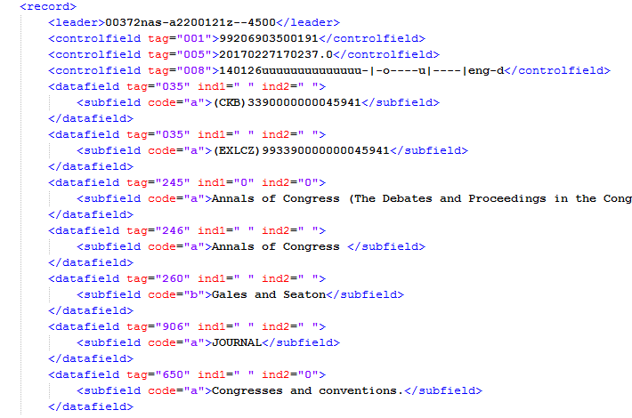
CZ electronic collection with updated bibliographic information
  For example this is part of the input file which will be loaded into the network institution. It is for portfolio title “Annals of Congress” and contains an LC subject “Congresses and conventions”

Slide 21
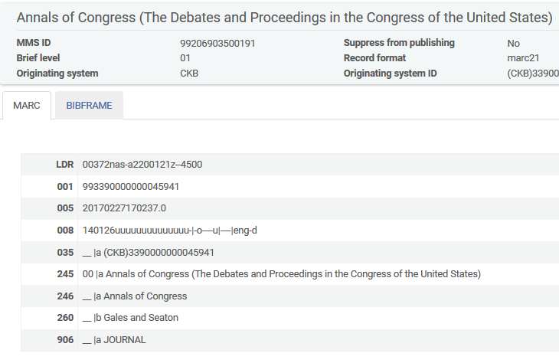
CZ electronic collection with updated bibliographic information
  The record in the Network Zone which exists from the activation from the CZ does not contain LC subject “Congresses and conventions”
No “650 0” field with “Congresses and conventions”

Slide 22
CZ electronic collection with updated bibliographic information
  We will now look at the import profile.
  Note that in order for the import profile to be able to update the bibliographic record and unlink it from the CZ we must set the following parameter “ignore_cz_records” to false:
  By setting “ignore_cz_records” to true we will have an option in the import profile to update the bibliographic record and unlink it from the CZ.
  The “ignore_cz_records” parameter is available under “Configuration menu > resources > general > other settings”

Slide 23
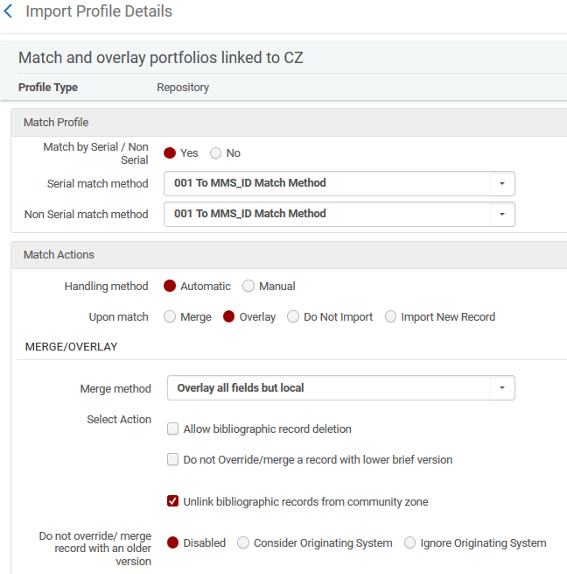
CZ electronic collection with updated bibliographic information
  In the network zone we have an import profile called “Match and overlay portfolios linked to CZ” of type “repository” which states “on match overlay record”
Here we state to overlay the CZ record with our local information from the input profile. This option exists because “ignore_cz_records” is set to “false”

Slide 24
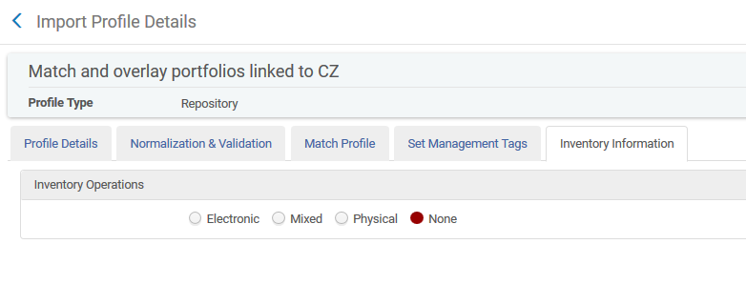
CZ electronic collection with updated bibliographic information
  The import profile called “Match and overlay portfolios linked to CZ” does not do anything to the inventory

Slide 25
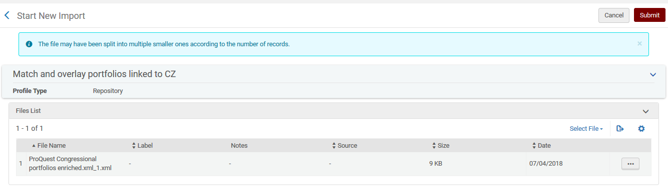
CZ electronic collection with updated bibliographic information
  The MARC file is imported

Slide 26
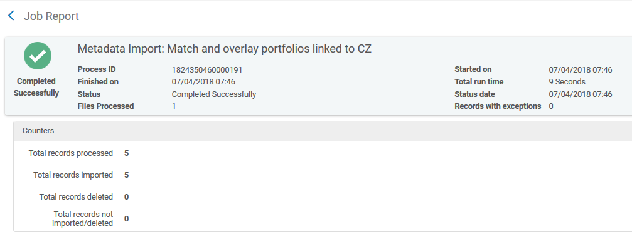
CZ electronic collection with updated bibliographic information
  We see from the report of the import that all five records were imported

Slide 27
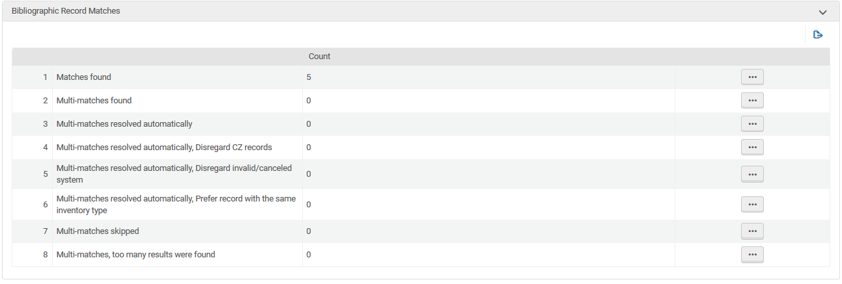
CZ electronic collection with updated bibliographic information
  We also see from the report of the import that all five records found a match

Slide 28
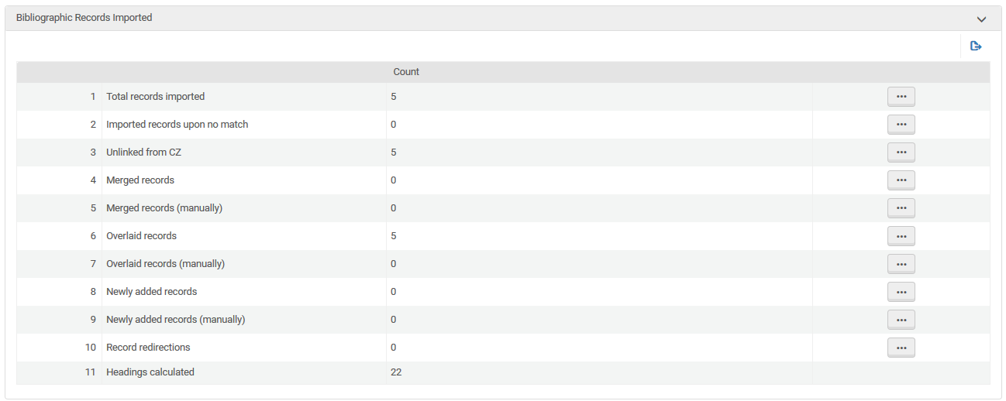
CZ electronic collection with updated bibliographic information
  Still further, we see from the report that there were five overlaid records unlinked from the CZ

Slide 29
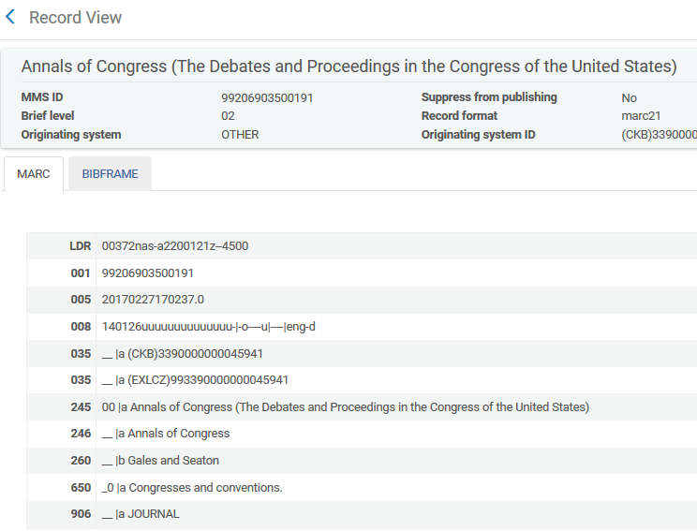
CZ electronic collection with updated bibliographic information
  Let’s look at the example we saw previously: title “Annals of Congress”
The “650 0” field with “Congresses and conventions” was added from the import profile

Slide 30
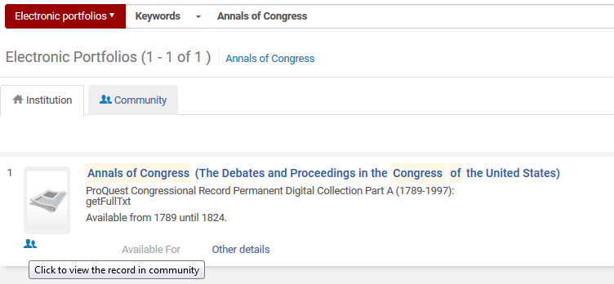
CZ electronic collection with updated bibliographic information
  The portfolio is still linked to the CZ

Slide 31
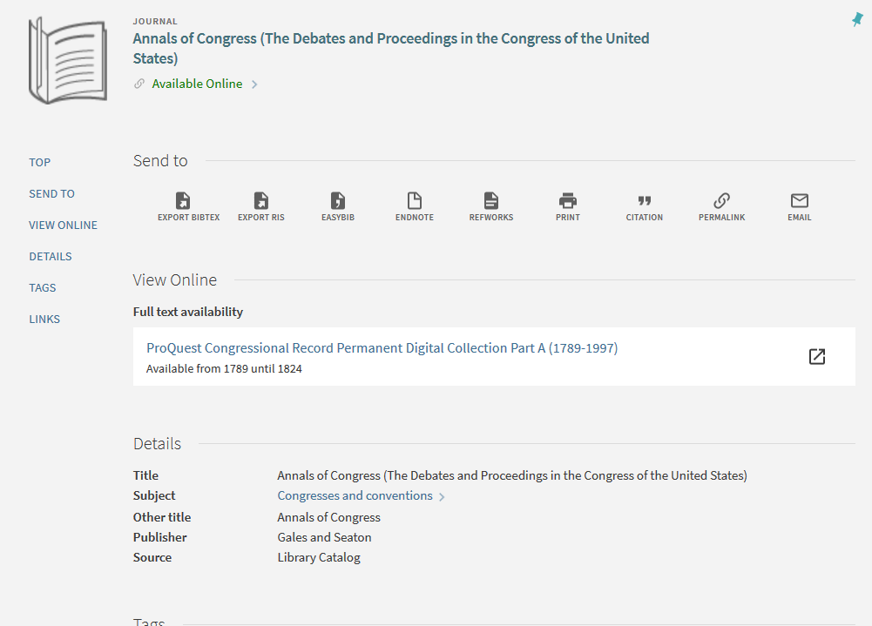
CZ electronic collection with updated bibliographic information
  In discovery we can see the link to the electronic resource from the CZ and the local bibliographic information from the network institution.

Slide 32
Introduction
CZ electronic collection
CZ electronic collection with updated bibliographic information
NZ local electronic collection
text
https://slidemodel.com/templates/animated-rainbow-business-powerpoint-template/
http://image.shutterstock.com/z/stock-photo-business-hand-writing-blank-agenda-list-130255148.jpg

Slide 33
NZ local electronic collection
See “Adding a local electronic collection” at:
https://knowledge.exlibrisgroup.com/@api/deki/files/49364/E_Resources_-_Adding_a_local_Electronic_Collection.pptx

